Slide 1
EC5314R Time Studies on Singapore’s Population Statistics
Ding Sen

Slide 2
Motivation
Abeysinghe, T (1991) “A seasonal analysis applied to Chinese births”, Journal of Applied Statistics
Seasonal variations of Chinese Births: Peak: Dragon Years and Trough: Snake Years, Chinese Zodiac
Population→ Singapore Stat: http://www.singstat.gov.sg/

Slide 3
Population Statistics
Infant Mortality Rate
2. Life Expectancy
3. Monthly Birth Rate

Slide 4
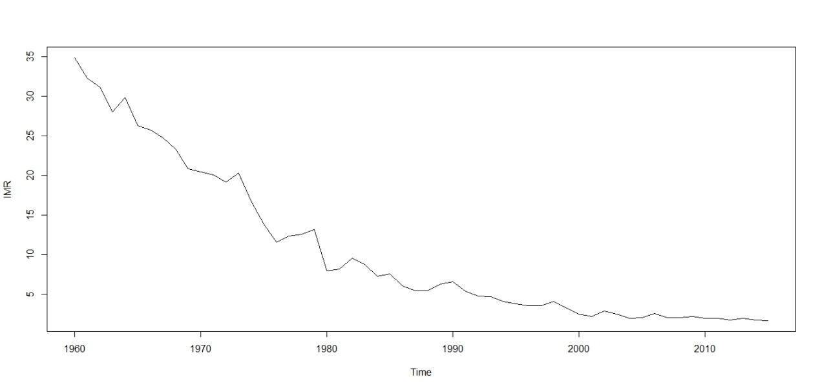
Infant Mortality Rate

Slide 5
IMR Graph Features
Rapidly declining ： public health effort pays off
2. Occasional Rebound: reasons to be further investigated.

Slide 6
IMR Forecast
Model: Δyt =0.992Δyt-1 + εt -1.6056 εt-1 + 0.7066 εt-2
Forecast IMR (2016~ 2025):
1.763893 1.724259 1.684942 1.645941 1.607253 1.568876 1.530807 1.493043 1.455583 1.418423

Slide 7
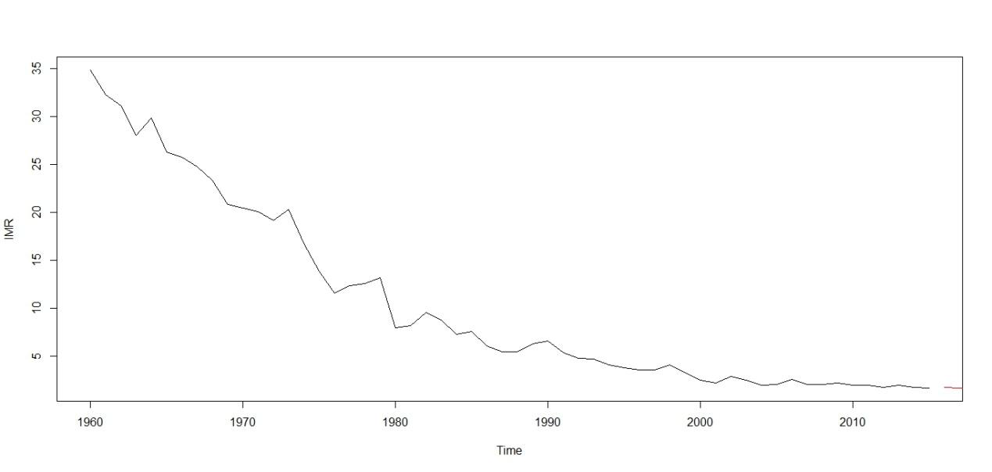
Forecast Infant Mortality Rate

Slide 8
Put IMR in perspective
1960: 35/1000
2016 (forecasted): 1.76/1000
International
China(2013): 10.9/1000, India (2013): 41.4/1000
UK(2013): 3.8/1000, Finland (2013): 1.8/1000
Hence, Singapore IMR one of the lowest in the world!

Slide 9
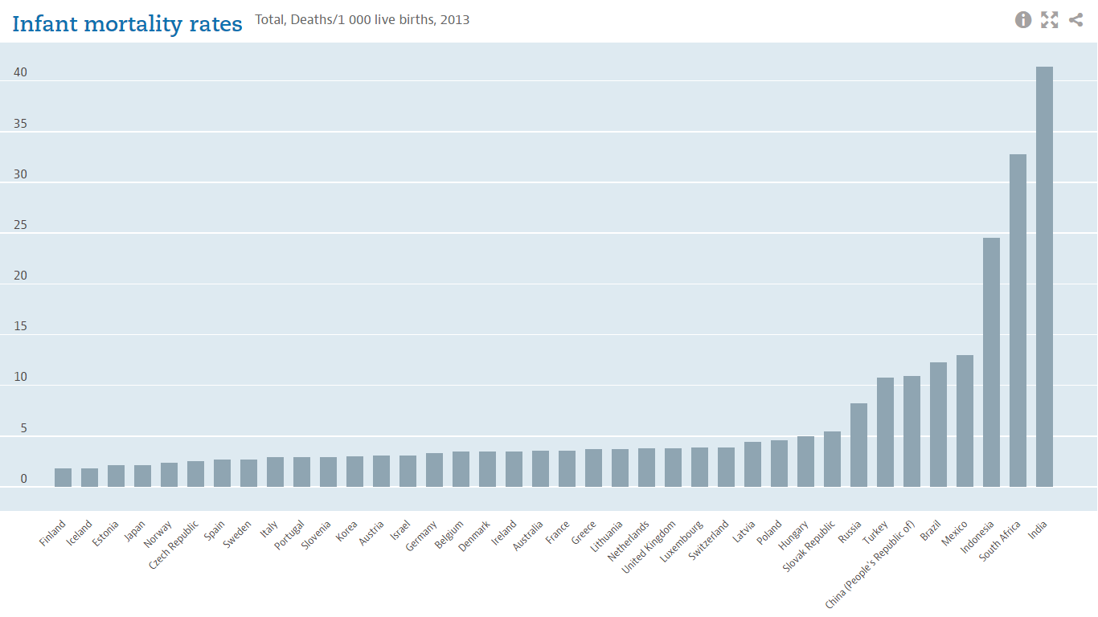

Slide 10
2. Life Expectancy
One at birth
One at 65 years. (Use this)

Slide 11
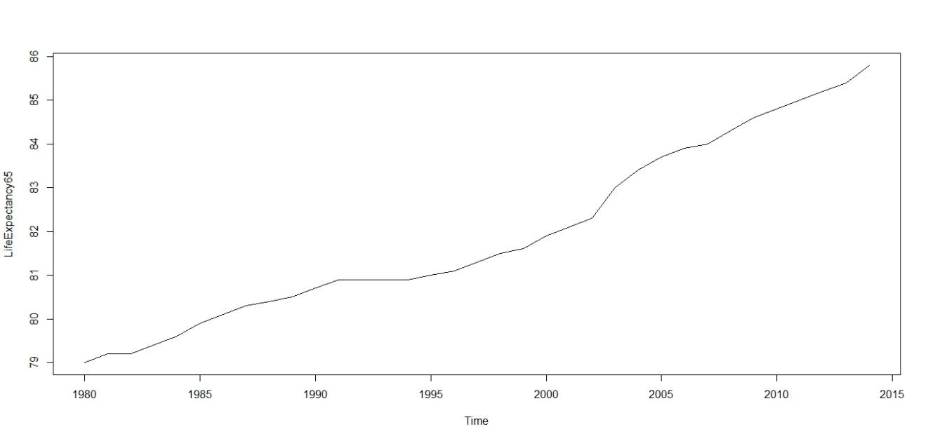
Life Expectancy (at 65 years)

Slide 12
Graph Features
79 years (1980) to 86 years (2015):Gaining seven years on average over three and a half decades
2. Surprisingly uniform increase in Life Expectancy: almost a straight line through!

Slide 13
Life Expectancy
The Model: Δyt =0.9729Δyt-1 + εt -0.6016 εt-1
Life Expectancy Prediction (2015-2024)
86.06581 86.32441 86.57600 86.82077 87.05891 87.29059 87.51599 87.73528 87.94862 88.15618
se: 0.1298586 0.2203897 0.3149346 0.4152226 0.5211845 0.6324022 0.7483982 0.8687120 0.9929200 1.1206387
Small SE: the forecasted life expectancy will be surprisingly accurate!

Slide 14
Implications of 7 years gain in life expectancy
Longer retirement→ Individuals prepare more resources for retirement!
Life Expectancy: 86.3 years(2016 forecasted) → retirement for 24 years!
2. Postponement of retirement years
Current: 62 years. → Rise to 67 years (2017)
In the new policy, 86.5（2017) → retirement for 21.5 years!

Slide 15
3. New Productivity: New Born Babies
Abeysinghe, T (1991): Chinese zodiac patterns
Could there be monthly patterns in addition to zodiac(yearly) patterns?

Slide 16
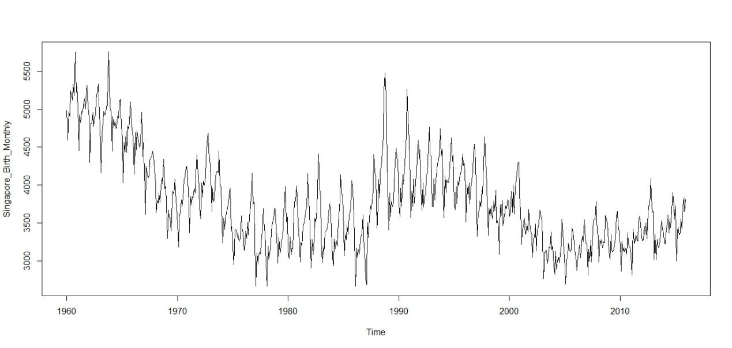
Monthly fresh life arrives in Singapore
Wave 1
Wave 2
Wave 3
Wave 4

Slide 17
Graph Patterns: Babies
Several waves:
Wave 1(1960~1980): babies number drops dramatically
Wave 2(1980~ 1994): babies number rebounds/rises
Wave 3(1994~ 2006): babies number drops again
Wave 4( post 2006): some stimulation effects worked! Babies number rises!
2. Overall Decline.
3. Strong Monthly Variations!
Minimum Monthly Babies: 2668.
Maximum Monthly Babies 5761.
Average New Monthly Babies: 3786.

Slide 18
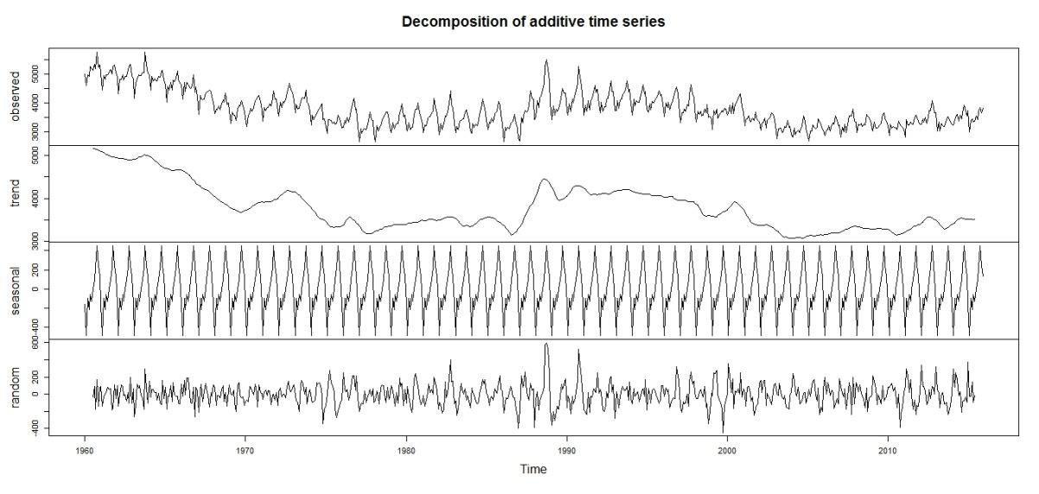
Decompose monthly babies series

Slide 19
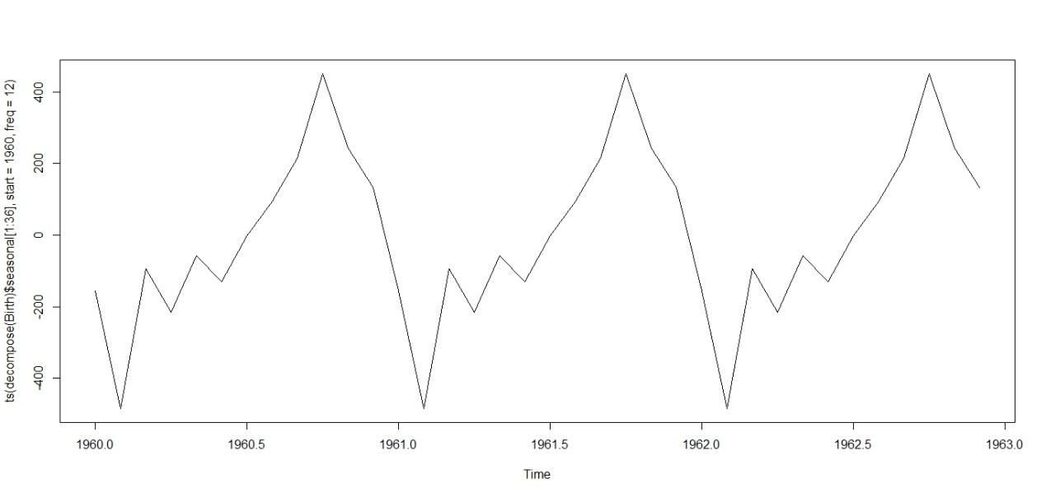
Monthly Variations

Slide 20
Singapore Monthly Births
Peaks: October(+451)
Troughs: February(-484)
Average monthly babies 3786, significant monthly variations!
Why? (10 monthly pregnancy period)
Peak, January: Christmas and New Year, more time for new babies
Troughs, April: most busy and stressed
Singapore’s new babies pattern closely resembled work-holiday patterns.

Slide 21
Who shall be concerned for the results?
Baby related industries, diapers, milk powders: peak demand after October, and trough starting from February.
Population divisions: less stress means more babies, , especially during April work season.

Slide 22
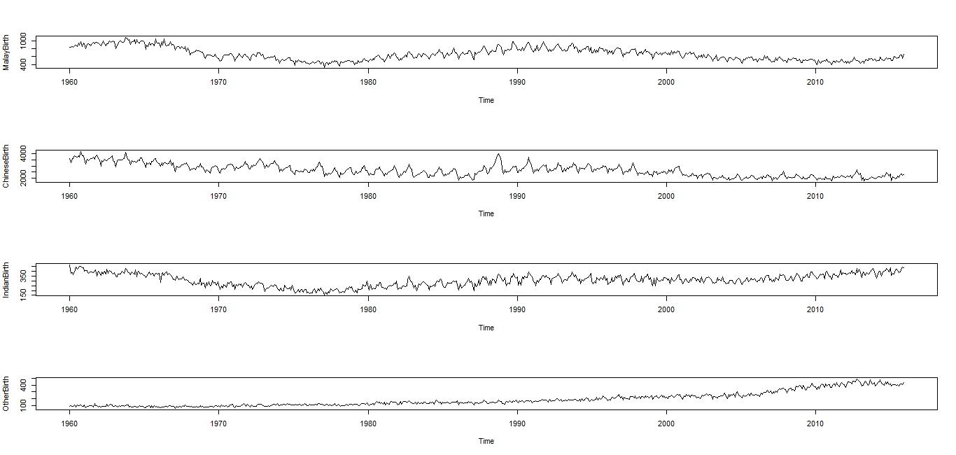
A new feature: Minorities catching up!
Monthly Newborn by Race

Slide 23
Thank you!

